Slide 1
UBER TRIP ANALYSIS
PROJECT BY: HANSA

Slide 2
INTRODUCTION
This project aims to analyze Uber trip data from January to February 2015.
The dataset contains information on trips made, dispatching base, and active vehicles.
The analysis helps understand travel patterns and predict trip demand.

Slide 3
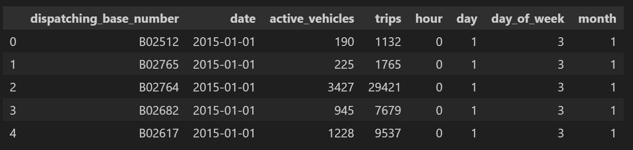
DATA PREPROCESSING
Loaded dataset and renamed columns: Base, Date, Active_Vehicles, Trips
Converted 'Date' column to datetime format
Extracted additional time features:
Day of the week
Month
Week number
Calculated 'Trips per Vehicle' for efficiency insights

Slide 4
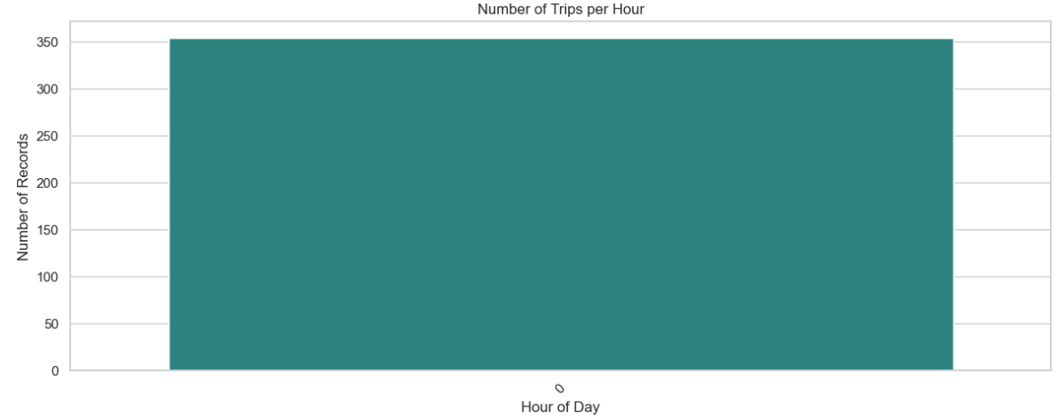
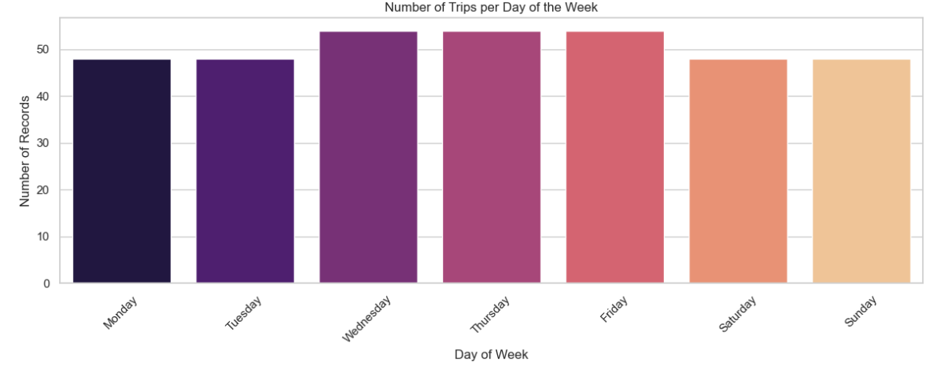
EXPLORATORY DATA ANALYSIS
GRAPH 1
Shows that the data is not hourly, but daily( per base)
GRAPH 2
Shows that Wednesday, Thursday and Friday are the busiest days.

Slide 5
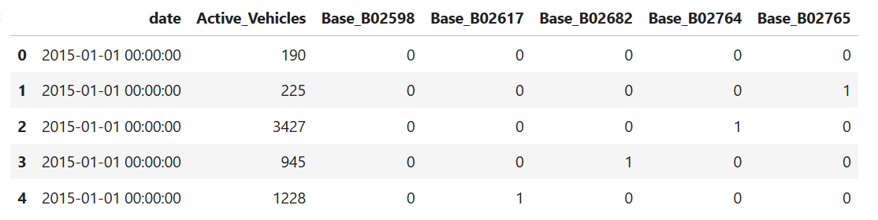
FEATURE ENGINEERING
Feature engineering is involved in creating meaningful inputs for the model, such as converting the categorical ‘Base’ column into dummy variables.
This ensured the data was in a fully numeric format, suitable for machine learning algorithms.

Slide 6
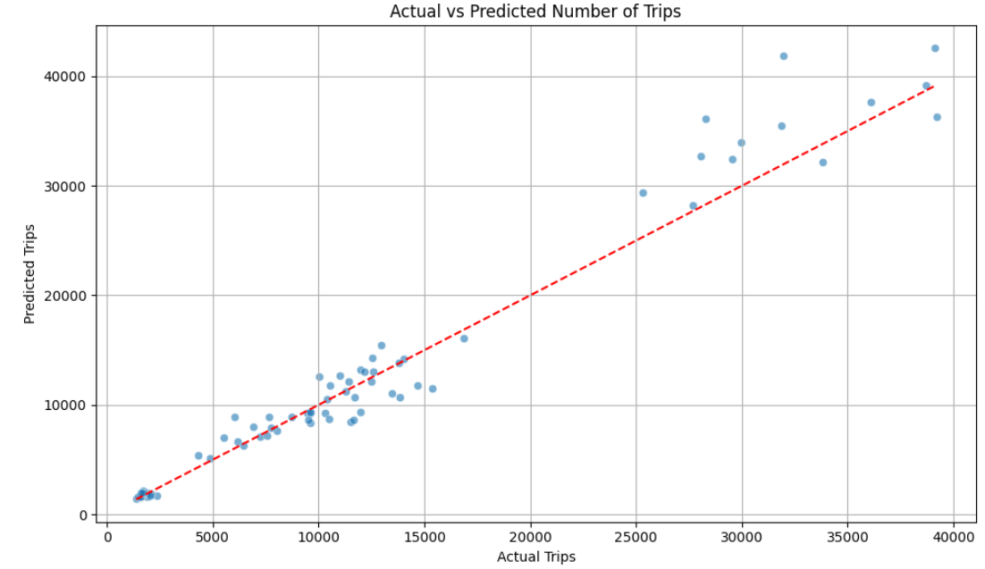
Model Performance and Evaluation
Mean Squared Error (MSE): 5,255,085.42
R² Score: 0.95
The model is performing very well, with a high R² score of 0.95.
Predictions are closely aligned with actual values, suggesting the model successfully captures time and base-level patterns in trip data.
The relatively low MSE indicates minimal average error in prediction.
A line or scatter plot comparing actual number of trips vs. predicted trips using the Random Forest model.
The closeness of the two lines indicates model accuracy.

Slide 7
CONCLUSION
Model Accurately Predicts Trip Demand:
Data-Driven Decisions Can Optimize Operations:
Peak Activity Patterns Identified:
.
Highest trip volumes were observed on Wednesdays, Thursdays, and Fridays, particularly between 5 PM and 7 PM, indicating peak demand hours for resource allocation.
The Random Forest model achieved a strong R² score of 0.95, confirming that trip volumes can be reliably predicted based on time and base features.
By leveraging trip trends and model insights, Uber can optimize driver deployment, reduce idle time, and enhance customer service during high-demand periods.

Slide 8
THANK YOU

